Slide 1
K-means Clustering
John R. Rose
Computer Science and Engineering
University of South Carolina

Slide 2
K-means Clustering
What is clustering?
Why would we want to cluster?
How would you determine clusters?
How can you do this efficiently?

Slide 3
K-means Clustering
Strengths
Simple iterative method
User provides “K”
Weaknesses
Often too simple → bad results
Difficult to guess the correct “K”

Slide 4
K-means Clustering
Basic Algorithm:
Step 0: select K
Step 1: randomly select initial cluster seeds
Seed 1 650
Seed 2 200

Slide 5
K-means Clustering
An initial cluster seed represents the “mean value” of its cluster.
In the preceding figure:
Cluster seed 1 = 650
Cluster seed 2 = 200

Slide 6
K-means Clustering
Step 2: calculate distance from each object to each cluster seed.
What type of distance should we use?
Squared Euclidean distance
Step 3: Assign each object to the closest cluster

Slide 7
K-means Clustering
Seed 1
Seed 2

Slide 8
K-means Clustering
Step 4: Compute the new centroid for each cluster
Cluster Seed 1 708.9
Cluster Seed 2 214.2

Slide 9
K-means Clustering
Iterate:
Calculate distance from objects to cluster centroids.
Assign objects to closest cluster
Recalculate new centroids
Stop based on convergence criteria
No change in clusters
Max iterations

Slide 10
K-means Issues
Distance measure is squared Euclidean
Scale should be similar in all dimensions
Rescale data?
Not good for nominal data. Why?
Approach tries to minimize the within-cluster sum of squares error (WCSS)
Implicit assumption that SSE is similar for each group

Slide 11
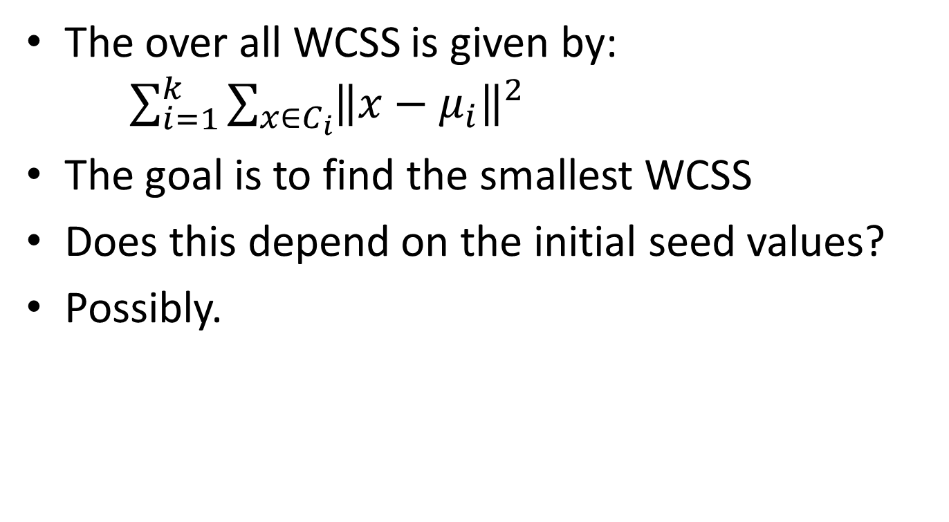
WCSS
The over all WCSS is given by: $\sum_{i=1}^{k}{\sum_{x∈C_{i}}{{\left\|x−μ_{i}\right\|}^{2}}}$
The goal is to find the smallest WCSS
Does this depend on the initial seed values?
Possibly.

Slide 12
Bottom Line
K-means
Easy to use
Need to know K
May need to scale data
Good initial method
Local optima
No guarantee of optimal solution
Repeat with different starting values

Slide 13
K-Means Lab
Pause this set of slides and switch to lab slides

Slide 14
Other Clustering in R
Hierarchical Clustering (agglomerative)
Create a distance matrix using ‘dist()’
Create the hierarchy using ‘hclust()’
Model Based Clustering
Use ‘mclust()’ to create the clusters on the basis of
Bayesian Information Criterion (BIC)
Parameterized Gaussian mixture models

Slide 15
Hierarchical Clustering
# Create the distance matrix
d <- dist(state_income$V2, method = "euclidean")
# Create the hierarchy
fit <- hclust(d, method="ward.D2")
# Plot the dendrogram
plot(fit)
# cut the tree into 6 clusters
Groups <- cutree(fit, k=6)
# Outline the 6 clusters
rect.hclust(fit, k=6, border="red")

Slide 16
How to Define Inter-Cluster Similarity
p1
p2
p3
p4
p5
. . .
p1
p2
p3
p4
p5
MIN
MAX
Group Average
Distance Between Centroids
Other methods driven by an objective function
Ward’s Method uses squared error
.
.
.
Proximity Matrix

Slide 17
How to Define Inter-Cluster Similarity
p1
p2
p3
p4
p5
. . .
p1
p2
p3
p4
p5
MIN == SINGLE LINKAGE
MAX == COMPLETE LINKAGE
Group Average
Distance Between Centroids
Other methods driven by an objective function
Ward’s Method uses squared error
.
.
.
Proximity Matrix

Slide 18
How to Define Inter-Cluster Similarity
p1
p2
p3
p4
p5
. . .
p1
p2
p3
p4
p5
MIN
MAX
Group Average
Distance Between Centroids
Other methods driven by an objective function
Ward’s Method uses squared error
.
.
.
Proximity Matrix

Slide 19
How to Define Inter-Cluster Similarity
p1
p2
p3
p4
p5
. . .
p1
×
×
p2
p3
p4
p5
MIN
MAX
Group Average
Distance Between Centroids
Other methods driven by an objective function
Ward’s Method uses squared error
.
.
.
Proximity Matrix

Slide 20
Hierarchical Clustering
# Other hierarchical methods
sfit <- hclust(d, method="single")
cfit <- hclust(d, method="complete")
afit <- hclust(d, method="average")
# Plot the histogram
op <- par(mar = c(0, 4, 4, 2), mfrow = c(2, 2))
plot(sfit, labels = FALSE, main = "Single", xlab = "")
plot(cfit, labels = FALSE, main = "Complete", xlab = "")
plot(afit, labels = FALSE, main = "Average", xlab = "")
plot(fit, labels = FALSE, main = "Ward", xlab = "")

Slide 21
Model-Based Clusters
This is more complicated that hierarchical or K-means clustering
# First load mclust package
#Create the cluster(s)
fit <- Mclust(state_income$V2)
# examine the result(s)
summary(fit)
# plot the result(s)
plot(fit)
#Not very satisfying. Try a different data set

Slide 22
Model-Based Clusters
# Load in a different data set (iris.data)
#Create the cluster(s)
fit <- Mclust(iris[,-5])
# examine the result
summary(fit)
# plot the result(s)
plot(fit)
# 1: display the model scores vs # clusters
# 2: display the classification based on the best scoring model
# 3: display the uncertainty (based on the best scoring model)
# 4: display the density (based on the best scoring model)
(for explanation of mixture models see https://www.ncbi.nlm.nih.gov/pmc/articles/PMC5096736/ )

